Slide 1
Noise Robust Digit Recognition
ECE M214A: Digital Speech Processing
Aki Hasegawa-Johnson, Advait Paranjpe, Farrah Galal

Slide 2
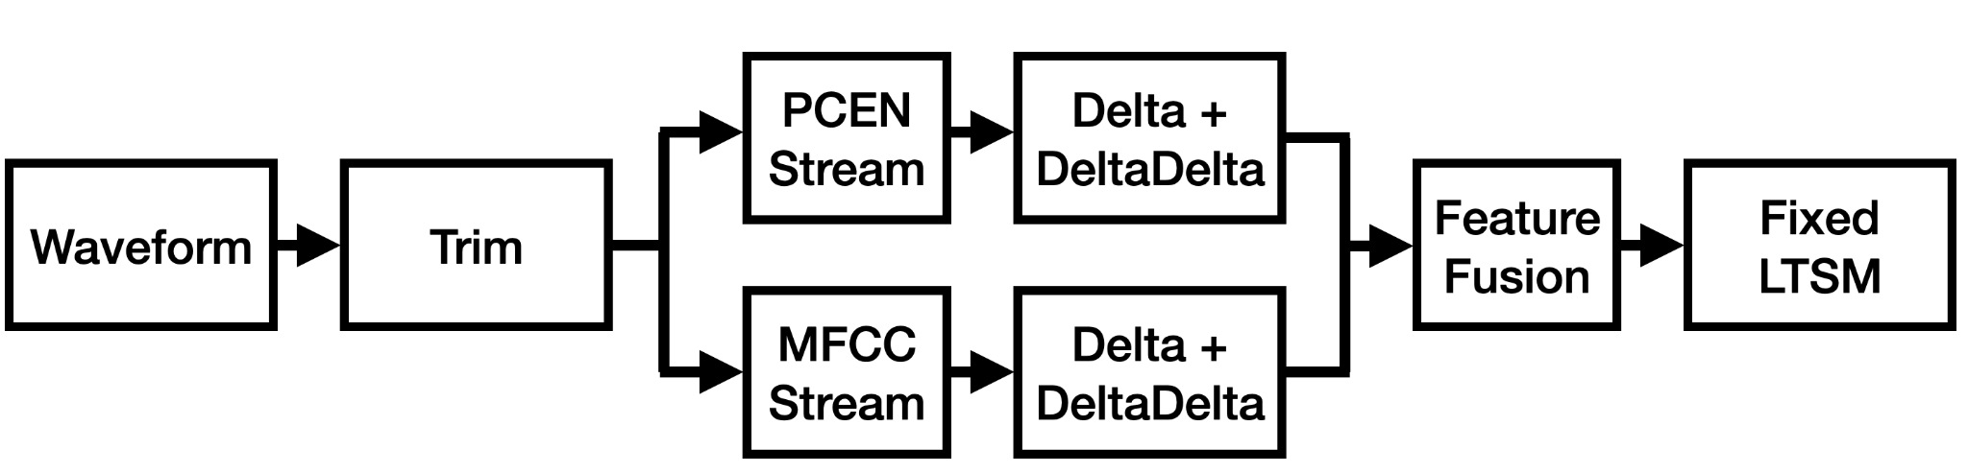
System Architecture Overview
We improve noisy spoken digit recognition by fusing PCEN and MFCC feature streams with temporal derivatives, while keeping the baseline BiLSTM fixed.
Notes:
typo

Slide 3

Trimming
Main Idea: Remove low-energy audio at the beginning and end so the model sees mostly the spoken digit, not padding.
Reduces silence and padding variability across recordings
Helps downstream features focus on speech rather than non-informative frames
top_db=40 is a conservative threshold that avoids cutting weak speech
silence
speech
silence
speech
Notes:
Before extracting any features, we first clean up the raw waveform by trimming low-energy regions from the beginning and end.
The motivation is that different recordings can contain different amounts of dead space before the speaker starts and after they finish. That variation is not part of the spoken digit, but if we leave it in, the feature extractor will still process it.
So here, we apply boundary trimming using librosa.effects.trim with top_db = 40. Conceptually, this removes leading and trailing regions whose energy is far below the main signal level.
The key point is that this is a conservative preprocessing step. We are not doing full voice activity detection, and we are not trying to remove pauses inside the word. We are mainly just cutting off obvious silence at the edges.
This helps in two ways. First, it reduces padding variability across recordings, so different samples are more aligned in terms of where the actual speech occurs. Second, it makes downstream feature extraction more speech-focused, because more of the frames now contain useful speech information instead of silence.
We chose top_db = 40 to avoid being too aggressive. That matters especially in noisy conditions, like 5 dB SNR, where parts of the speech may already be weak. So the tradeoff here is: remove clear non-informative boundaries, but preserve as much real speech as possible.
Finally, there is a guard case in the code: if trimming removes everything, or if the input is empty, we return a zero feature tensor of the expected shape. That keeps the pipeline robust and ensures the classifier always receives a valid input.

Slide 4
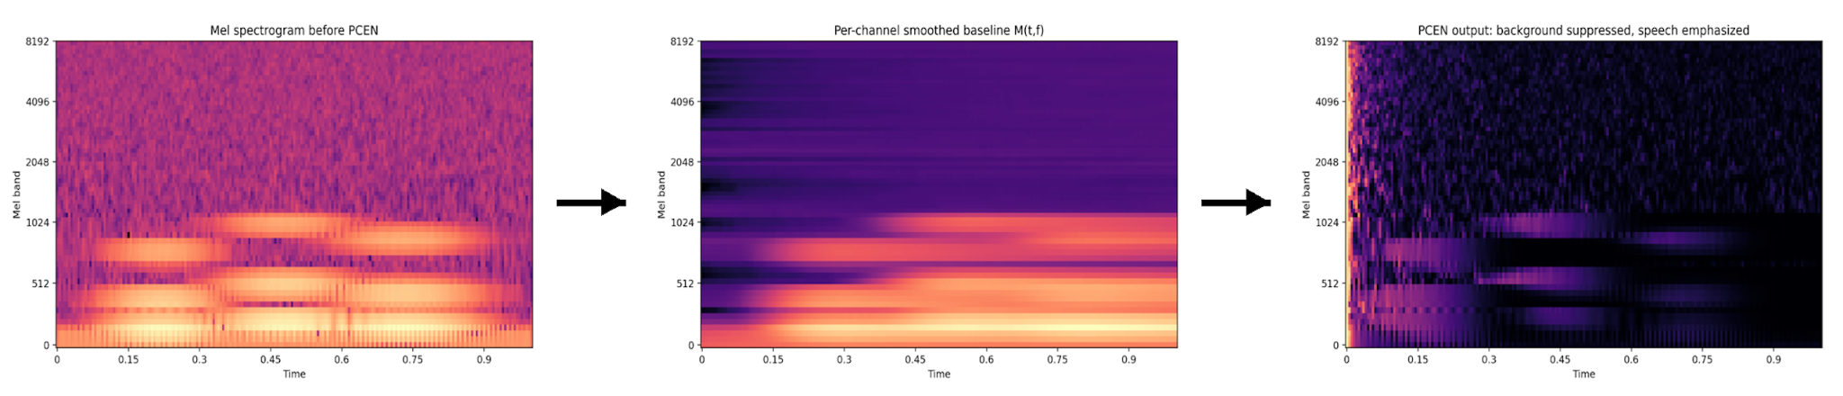
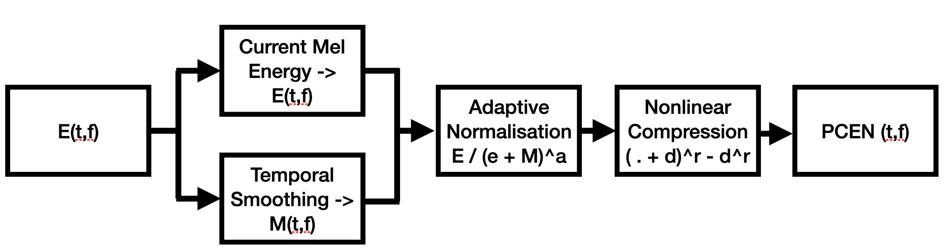
PCEN (Per-Channel-Energy-Normalization)
Notes:
After trimming, we convert the waveform into a mel spectrogram, which gives us energy over time in perceptually spaced frequency bands. That is the first matrix, E(t,f)E(t,f), shown here. The issue is that this representation still contains a lot of steady background energy, so the speech structure is not as cleanly separated as we would like.
To address that, we smooth each mel band over time using a first-order IIR-style update. This produces a second matrix, M(t,f)M(t,f), which acts as a running baseline or recent typical energy level for each band.
We then normalize the current mel energy relative to that baseline. So instead of caring about absolute energy, the feature now cares more about energy that stands out above what has recently been normal in that band. That suppresses steady background and makes speech-driven changes more prominent.
Finally, we apply nonlinear compression to reduce dynamic range. This prevents very large peaks from dominating the representation and helps preserve weaker but still informative parts of speech. The end result is a more balanced and noise-robust feature, which is why PCEN helps so much in our noisy spoken-digit setting.

Slide 5
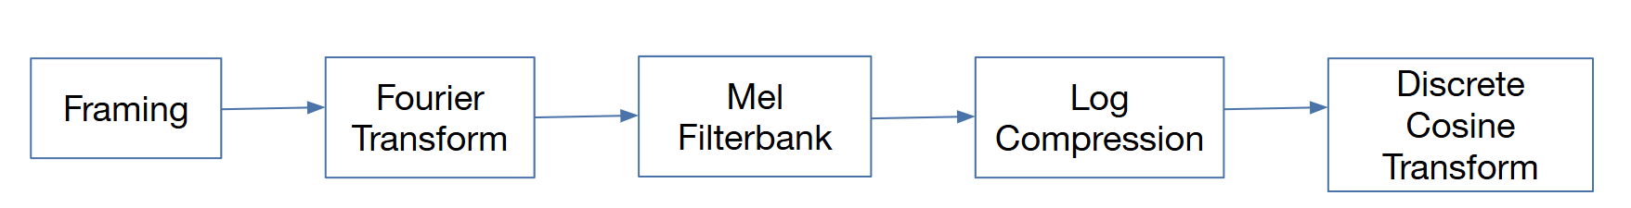
MFCC
Key Idea:
We need features that capture important speech structure while reducing dimensionality.
Speech perception is largely determined by the spectral envelope of the vocal tract rather than the raw waveform.
MFCCs (Mel-Frequency Cepstral Coefficients) summarize the shape of the speech spectrum in a compact form that reflects how humans perceive sound.
MFCC Pipeline:
Notes:
Definition: The Mel scale is a perceptual scale of pitch that reflects how humans perceive differences in sound frequency. MFCC uses Mel filterbanks, which use space frequency bands according to the Mel scale. This ensures the extracted features emphasize frequencies important for human speech perception, improving performance in speech recognition tasks.
Mel-Frequency Cepstral Coefficients (MFCCs) are features that describe the spectral envelope of speech using a perceptually motivated frequency scale. They approximate how the human ear processes sound frequencies.
MFCC Extraction Pipeline
Framing
Split audio into short windows (~25 ms)
Fourier Transform
Convert each frame from the time domain to the frequency spectrum
Mel Filterbank
Group frequencies using the Mel scale, which matches human hearing sensitivity
Log Compression
Apply log to mimic human loudness perception
Discrete Cosine Transform (DCT)
Compress information into a small set of coefficients (typically 13 MFCCs)
For speech recognition tasks like digit classification, the broad spectral envelope is what matters most, because it reflects the vocal tract configuration that produces phonemes. Lower coefficients (1–13) capture the overall shape of the spectral envelope.

Slide 6
CMVN
Motivation: Speech recordings can vary due to:
microphone differences
recording environments
speaker loudness
channel effects
These variations can shift the average value and scale of features, even when the spoken content is the same. This mismatch can make it harder for the model to learn consistent patterns. CMVN reduces this variability by normalizing the feature distribution. This removes recording-specific bias and ensures the model focuses on speech structure rather than recording conditions.
Definition: Cepstral Mean and Variance Normalization (CMVN) is a feature normalization technique used in speech processing to standardize cepstral features (such as MFCCs).
For each feature coefficient across time:
subtract the mean
divide by the standard deviation
Notes:
In our pipeline:
MFCC features were extracted from each audio frame
CMVN was applied across the utterance
Delta and delta-delta features were then computed
This normalization improves feature consistency, helping the LSTM classifier generalize better across recordings.

Slide 7
Delta + Delta-Delta
Let x_{t}​ be the base features at time frame t. Delta features capture the first-order temporal change of each feature (first derivative)
Δx_{t​} ≈ (x_{t+1​}− x_{t−1​​}) / 2
Delta-Delta features capture the second-order temporal change (second derivative)
Δ²x_{t​} ≈ (Δx_{t+1​}− Δx_{t−1​​}) / 2
These derivatives help represent the dynamic structure of speech
Spoken digits are short sequences, so modeling how features evolve over time is important
Advantages:
Improves separation between digits with similar static acoustic patterns
Helps capture transitions between consonants and vowels
Gives the model both frame-level content and temporal motion
Notes:
Static features tell us what the sound looks like at one moment, while delta and delta-delta tell us how that sound is moving over time.

Slide 8

Feature Fusion and LSTM Classification
For both the PCEN stream and the MFCC stream, we computed static, delta, and delta-delta features
We then performed feature fusion by stacking both streams together into one feature vector
Dimensions:
PCEN stream: 64 + 64 + 64 = 192 dims
MFCC stream: 13 + 13 + 13 = 39 dims
Final fused input: 192 + 39 = 231 dims per frame
The LSTM receives the sequence of fused frame-level features and models temporal dependencies across the utterance
Final output is the predicted digit from 0–9
static PCEN
(64, T)
(231, T) feature vector
delta PCEN
(64, T)
delta-delta PCEN
(64, T)
static MFCC
(13, T)
delta MFCC
(13, T)
delta-delta MFCC
(13, T)
Notes:
Fusion means combining both feature streams into one representation so the LSTM can learn from both the noise-robust PCEN information and the classic MFCC information at the same time.

Slide 9
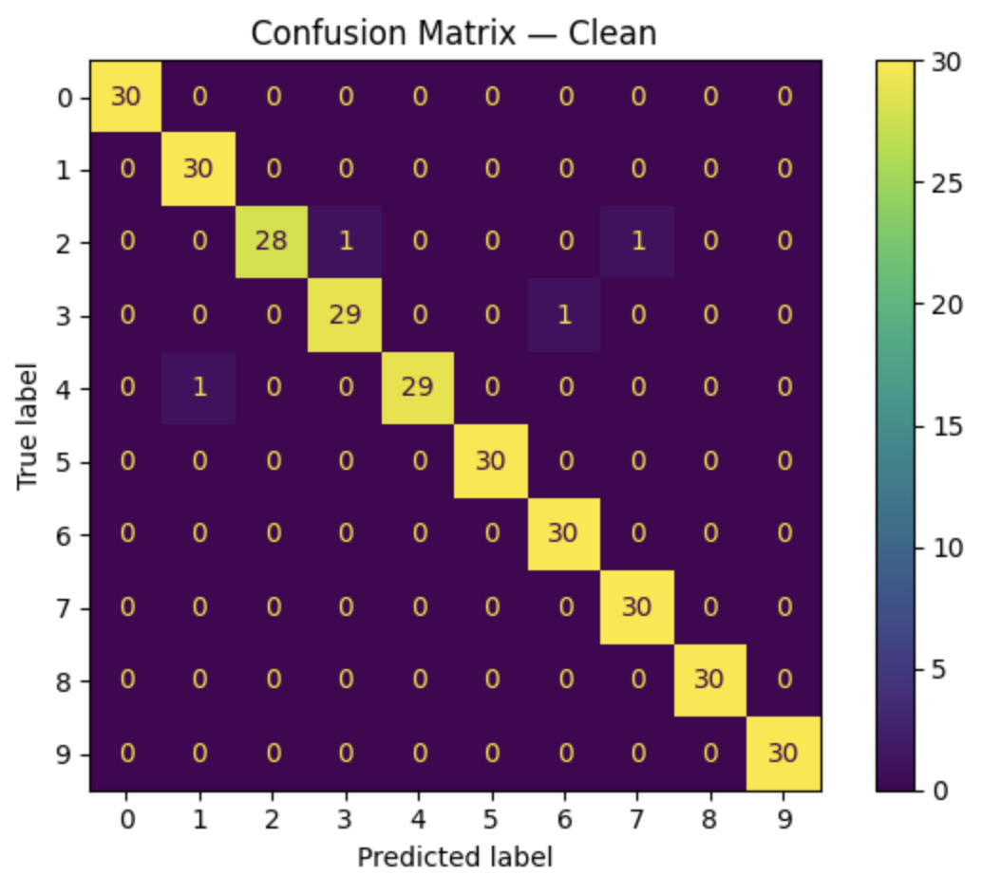
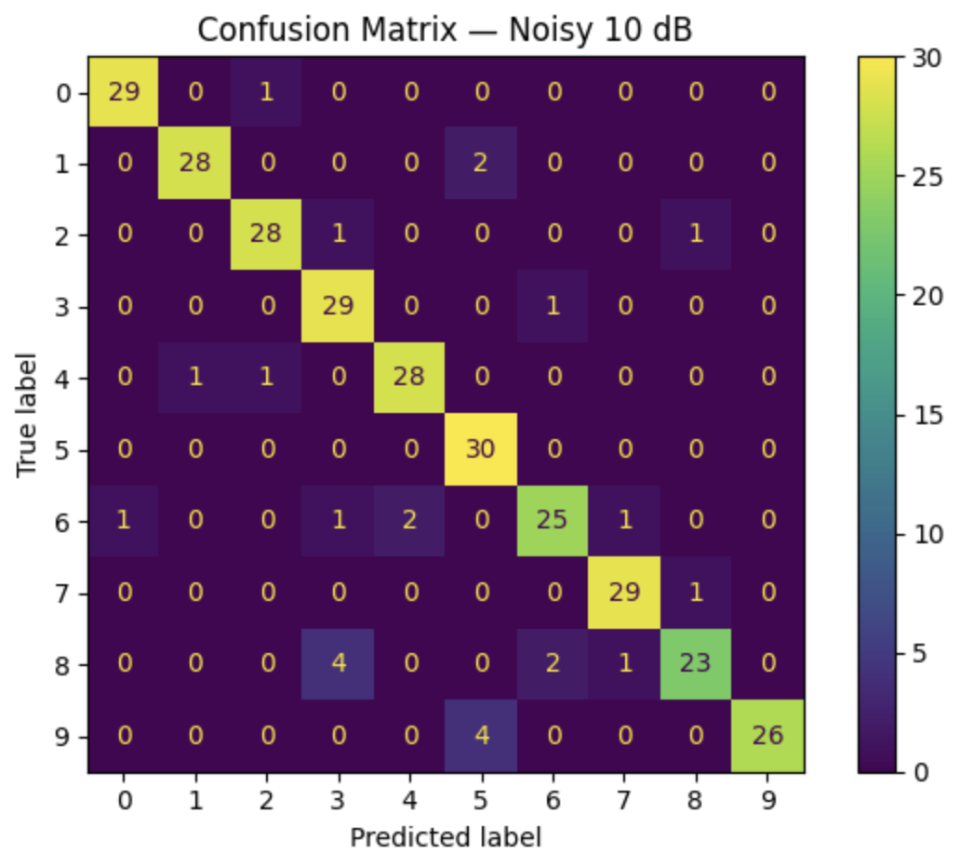
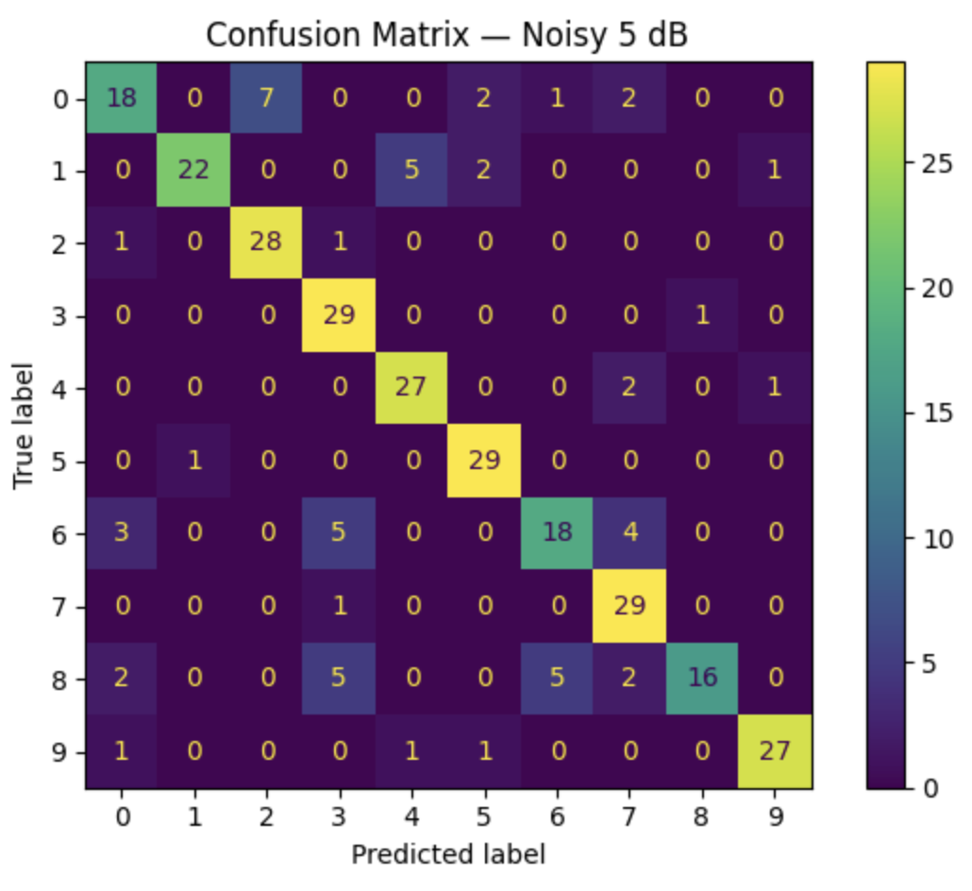
Results
Dataset | Accuracy
Test Clean | 98.67%
Test Noisy 10dB | 91.67%
Test Noisy 5dB | 81.00%
Notes:
Overall trend:
Clean performance is nearly perfect.
Performance is strong at 10 dB.
The largest error occurs at 5 dB, where background noise is most severe.
Confusion matrices:
Noise mainly affects digits with more similar spectral/temporal patterns
Errors increase when noise masks the fine acoustic cues needed to distinguish similar pronunciations
Still the fused features are highly effective, especially at 10 dB

Slide 10
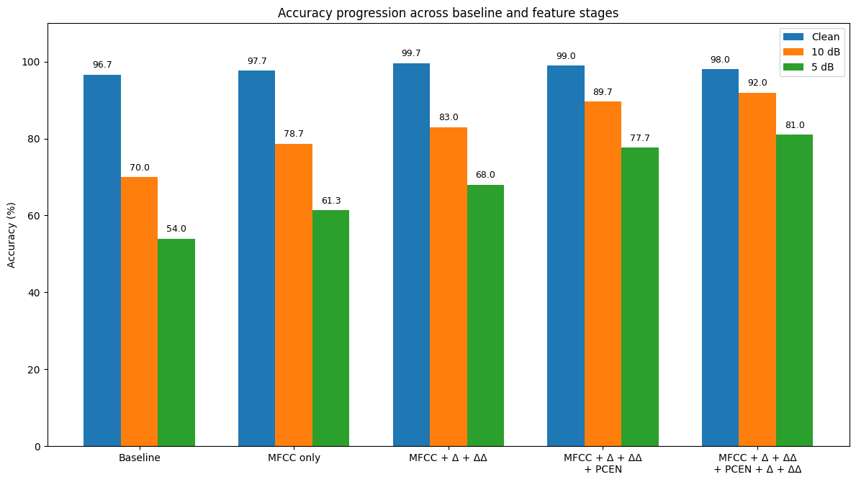
Results
Notes:
In order of how we iterated

